Slide 1

Sanjivani Rural Education Society’s
Sanjivani College of Engineering, Kopargaon-423 603
Department of Computer Engineering
A
Presentation
On
Machine Learning for CIA II Activity
“Traffic Violation Prediction using Machine Learning
to Identify High-Risk Zones
Based on Historical Traffic and Camera Data”
Presented by
121 | UCS23M1121 | Sonawane Kartik Ashok
131 | UCS23M1131 | Waghmode Prasad Bapu
137 | UCS23M1137 | Zalte Harshwardhan Anil
153 | 0124UCSM2014 | Shinde Tanmay Santoshkumar
Department of Computer Engineering
TY B Tech 2025-26 SEM VI
DEPARTMENT OF COMPUTER ENGINEERING, Sanjivani COE, Kopargaon
1
Notes:
1.7.2013
‹#›

Slide 2

Problem Definition
1
Rising cases of overspeeding, signal jumping, lane violations & wrong-side driving create severe road safety hazards
2
Traditional traffic monitoring is manual, inconsistent, and lacks predictive capability
⚠️
ROAD
RISK
ALERT
3
City traffic departments struggle to deploy patrol resources efficiently without risk-zone data
4
Violations contribute to accidents, congestion, and loss of lives — demanding an intelligent solution
5
Existing systems react to violations after the fact rather than forecasting high-risk zones proactively
6
No unified platform correlates camera data, historical records, and environmental factors for prediction
DEPARTMENT OF COMPUTER ENGINEERING, Sanjivani COE, Kopargaon
2
Notes:
1.7.2013
‹#›

Slide 3
Objectives
Predict High-Risk Zones
Automate Detection
Develop ML models to forecast violation-prone road segments using historical and real-time data
Automate the identification of traffic violations using camera footage and OpenCV-based feature extraction
Multi-Model Evaluation
Real-Time Dashboard
Train & compare Logistic Regression, Decision Trees, Random Forest, and Gradient Boosting models
Deploy a Flask/Streamlit dashboard showing heatmaps, risk scores, and automated alerts
Support Smart Cities
Performance Metrics
Enable proactive policing, optimized patrol planning, and smarter signal regulation
Validate models using Accuracy, Precision, Recall, F1-Score, and ROC-AUC for reliable results
DEPARTMENT OF COMPUTER ENGINEERING, Sanjivani COE, Kopargaon
3
Notes:
1.7.2013
‹#›

Slide 4
Proposed Solution
Traffic Violation Prediction & High-Risk Zone Identification System
DATA INPUT
DATA PROCESSING
FEATURE EXTRACTION
ML MODELS
PREDICTION & OUTPUT
Traffic records
Camera footage
Speed / Weather
Pandas/NumPy
Cleaning
Feature Eng.
OpenCV
Speed norm.
Violation freq.
Logistic Reg.
Random Forest
Gradient Boost
Risk Score
Heatmap
Alerts
OUTPUT:
Violation Probability
(0–1)
Risk Zone: Low /
Medium / High
High-Risk Road Segments List
Violation Heatmaps & Trend Charts
Model Metrics: Accuracy / F1 / ROC-AUC
4
Notes:
1.7.2013
‹#›

Slide 5
Dataset Information
Table 1: Dataset Description
Attribute | Details
Dataset Name | Traffic Violation & Accident Records Dataset
Source | Kaggle / City Traffic Department / Surveillance Camera Logs
Total Records | ~50,000+ violation records (varies by city/dataset)
Total Features | 12–16 (mixed numerical + categorical)
Data Type | Mixed (Numerical + Categorical + Image metadata)
Target Variable | Violation_Risk (Low / Medium / High Zone)
Domain | Urban Traffic Safety / Smart City Analytics
Missing Values | Present – handled during preprocessing stage
Usage | Training ML models for high-risk zone prediction
Key Input Features
Traffic Density
Vehicle Speed
Time of Day
Weather Conditions
Camera Violation Logs
Past Accident History
Road Category
Signal Timing Data
DEPARTMENT OF COMPUTER ENGINEERING, Sanjivani COE, Kopargaon
5
Notes:
1.7.2013
‹#›

Slide 6
Working Traffic Violation Prediction System
Traffic Violation Prediction & High-Risk Zone Identification Pipeline
Raw Traffic
Violation Records
Surveillance
Camera Footage
Speed &
Density Sensors
Weather &
Time Data
▼
Data Cleaning
& Integration
Feature Engineering
(Speed norm, Freq score)
OpenCV Feature
Extraction (Camera)
▼
Logistic
Regression
Decision
Tree
Random
Forest
Gradient
Boosting
▼
OUTPUT: Risk Score (0–1) | Zone Classification (Low/Medium/High) | Heatmaps | Alerts Dashboard | Patrol Recommendations
DEPARTMENT OF COMPUTER ENGINEERING, Sanjivani COE, Kopargaon
5

Slide 7
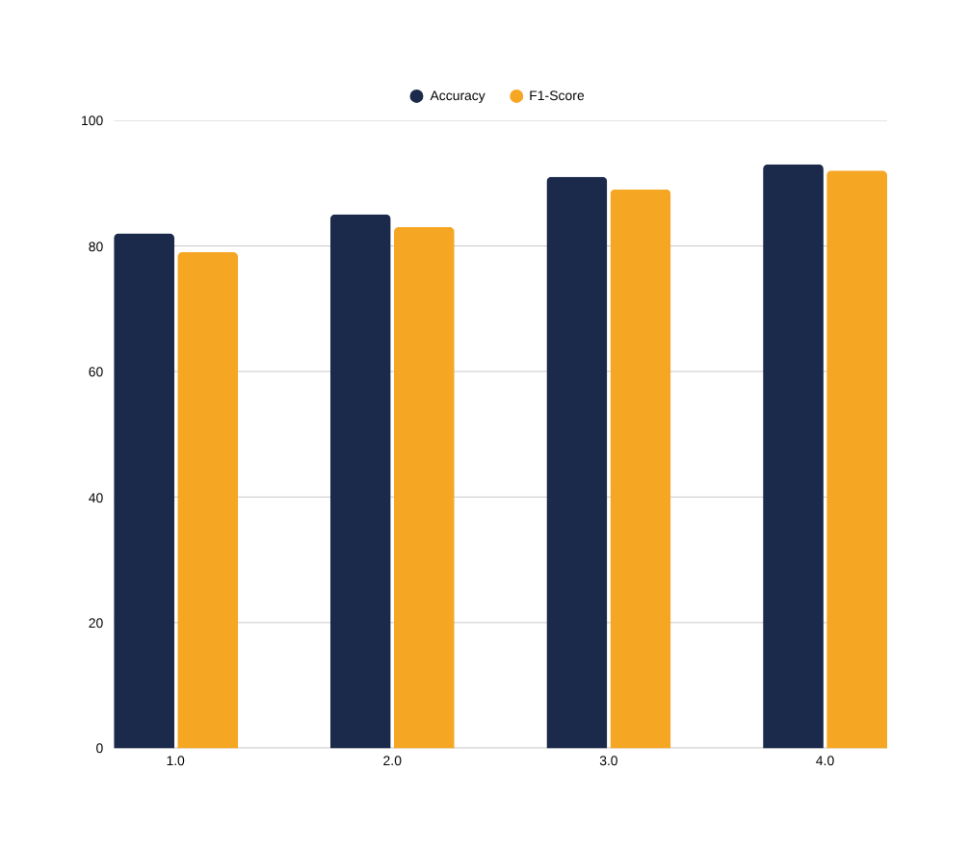
Model Performance
TP: 312
FP: 28
FN: 31
TN: 229
Predicted
Accuracy
93%
Precision
91%
Recall
90%
F1-Score
92%
ROC-AUC
0.95
DEPARTMENT OF COMPUTER ENGINEERING, Sanjivani COE, Kopargaon
6
Notes:
1.7.2013
‹#›

Slide 8
Scope of Project
1. Functional Scope
2. Application Scope
Accepts traffic records, speed data & camera logs as input
Used by city traffic departments and smart city platforms
Predicts violation probability and risk zone classification
Assists police in proactive patrol zone planning
Generates heatmaps and high-risk segment lists
SCOPE
Can integrate with government road-safety schemes
3. Business Scope
4. Technical Scope
Reduces accident rates and congestion in urban areas
Python stack: Pandas, NumPy, OpenCV, Scikit-learn, Matplotlib
Enables faster, data-driven traffic management decisions
Deployment via Flask/Streamlit dashboard with real-time alerts
Improves public safety and lowers operational costs
Scalable architecture supporting cloud integration & live feeds
DEPARTMENT OF COMPUTER ENGINEERING, Sanjivani COE, Kopargaon
7
Notes:
1.7.2013
‹#›

Slide 9
Future Scope
➤
Integrate real-time camera streams and live traffic feeds for continuous zone risk updates
➤
Use advanced Deep Learning models (CNN, LSTM) to enhance prediction from video data
➤
Develop a mobile application for field traffic officers to receive instant high-risk zone alerts
➤
Connect system with smart signal regulation infrastructure for automated traffic control
➤
Expand to multi-city deployments using cloud-hosted scalable infrastructure
➤
Implement Explainable AI (XAI) to justify risk predictions for legal and policy use
DEPARTMENT OF COMPUTER ENGINEERING, Sanjivani COE, Kopargaon
7

Slide 10
THANK YOU
Traffic Violation Prediction using Machine Learning
to Identify High-Risk Zones

